Slide 1
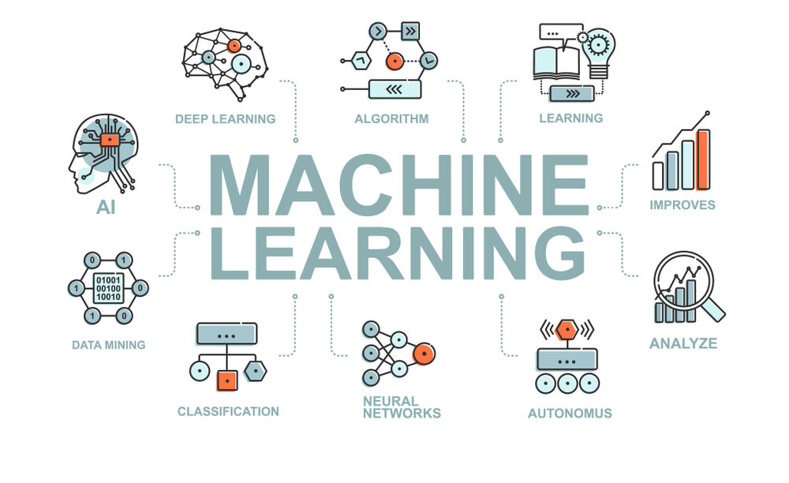
SC1015 MINI PROJECT
Huang Ting
Abhiraj Gupta
Notes:
Good morning, everyone. We are group XXX, I am Huang Ting and with me here my teammate gupta.
Today, we will be talking to you about disease prediction using machine learning. The dataset we will be using is the "Disease prediction using machine learning by kaushil268 from kaggle.
Singapore is known for its fast-paced and hectic lifestyle, which can make it difficult for individuals to prioritize their health. Due to work and other responsibilities, many working adults and even students may neglect small symptoms or put off seeing a doctor until it is too late. This can lead to more serious health problems and costly medical bills. The prognosis of these diseases can be costly, both in terms of individual's time and money. So this leads to our problem, how does individuals monitor their health status conveniently and affordably.
This is where disease prediction models can be useful. By using different symptoms as factors , these models can accurately predict the likelihood of an individual developing a particular disease, such as hypertension and heart attack. With this information, individuals can detect health risks early and take preventative measures or seek professional assistance, this reduces an individual's risk of developing the disease or worsening of conditions and improve their overall health outcomes.

Slide 2

CONTENTS
Problem statement
Exploratory data analysis
Machine learning
Visualisation
Insights

Slide 3






OUR GAME PLAN
CLEANING THE DATASET
FINDING THE RARITY OF SYMPTOMS
PREDICTION MODEL
FINDING THE DATASET
PLOTTING TO SEE THE DATASET
LOGISTIC REGRESSION
ARTIFICIAL NEURAL NETWORK

Slide 4


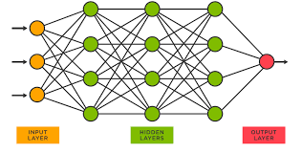
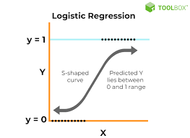
How does individuals monitor their health status conveniently and affordably?
Disease Prediction Model

Slide 5
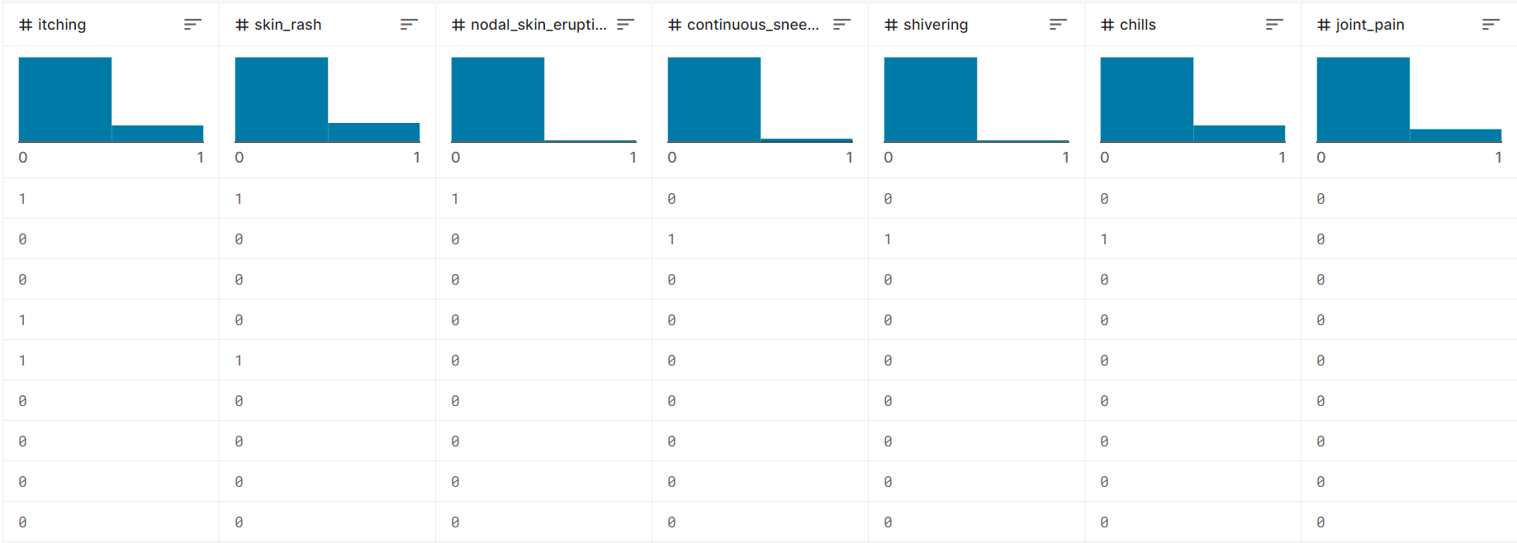
OUR DATA-SET
Consists of 133 columns of various diseases.
Total the data set consists of 4962 rows .
Notes:
The disease prediction dataset we are using consisting of 132 columns of symptoms with binary input of 0 or 1s to indicate presence of a particular symptoms and 1 column named prognosis consisting of potential diseases with respect to each combination of symptoms. We started our eda by checking for null values, empty entries and outliers which we found none. We then proceed to count the numbers of each unique prognosis and found out that our data set is balanced with each prognosis of count between 121 and 122. Next we explored the most common symptoms such as feeling fatigue, vomitting and high fever as well as some of the rare ones we should be more wary off such as foul smell of urine and swollen blood vessels. We then created a drop down list of diseases which will display a histogram of the top 5 symptoms related to the disease selected. we then followed to explore some of the common diseases singaporeans face namely heart attack and diabetes and the most common symptoms related to them. For heart attack we see that chest pain, vomitting , breathlessness and sweating are the most common shared symptoms of a potential heart disease patient, so if anyone has all of these symptoms at one go, he or she should seek professional medical attention immediately. And if an individual experience increase appetite, polyuria, fatigue and weightloss, he or she is likely to be a victim of diabetes. So in terms of setting up the analysis and machine learning problem, we plan to use supervised machine learning model to train on symptoms related to different diseases and use the train model to predict on the test sets. To prepare our data for training, we first plotted a correlation matrix between our predictors and filter out those predictors with correlation of more than 0.7 to make sure that our model does not overfit. Then, we encode the prognosis from object type to numerical for training, and lastly we split our data into 60% training set and 40% test set.

Slide 6
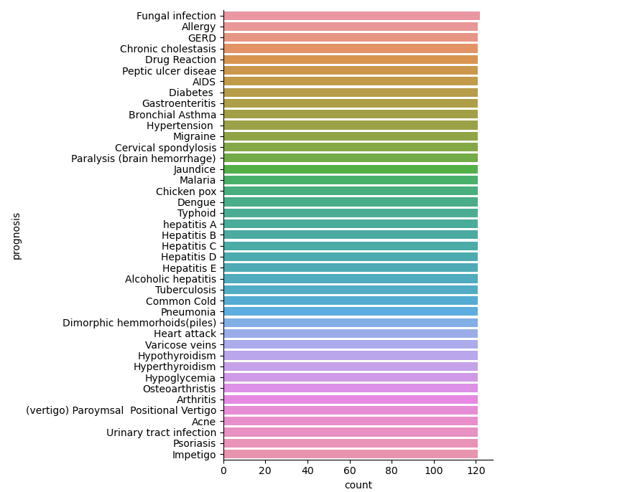
EXPLORATORY DATA ANALYSIS
Count of Each prognosis 121-122

Slide 7
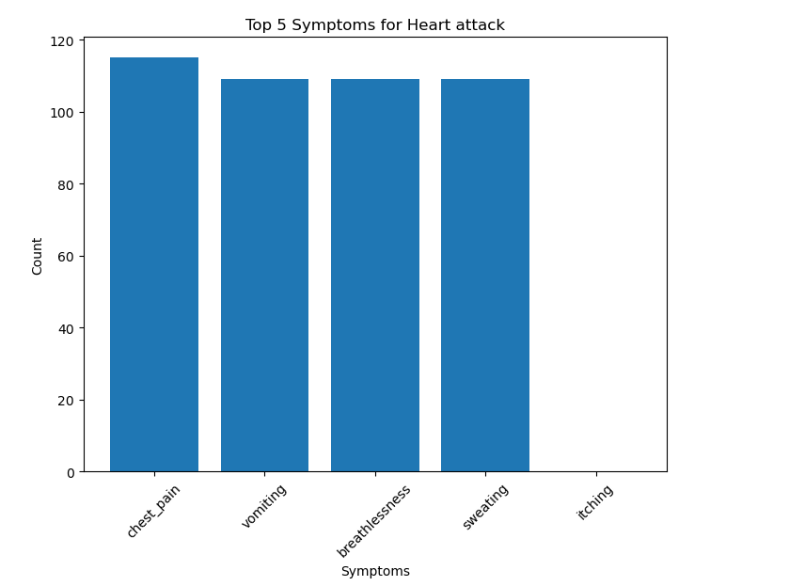
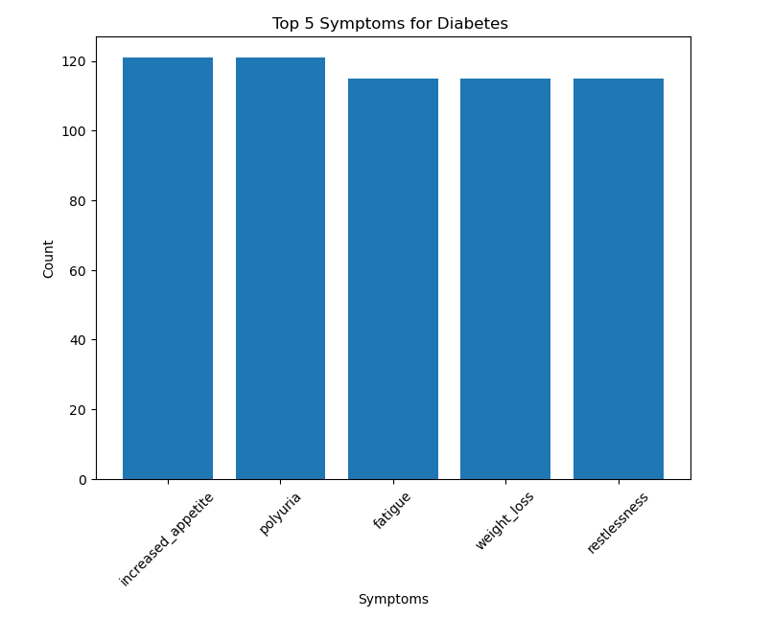
Common symptoms corresponding to prognosis

Slide 8
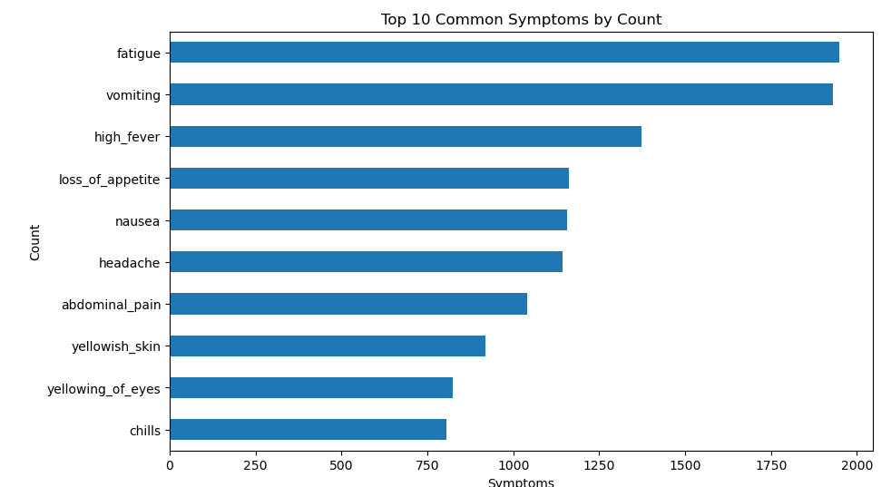
Top 10 most common symptoms

Slide 9
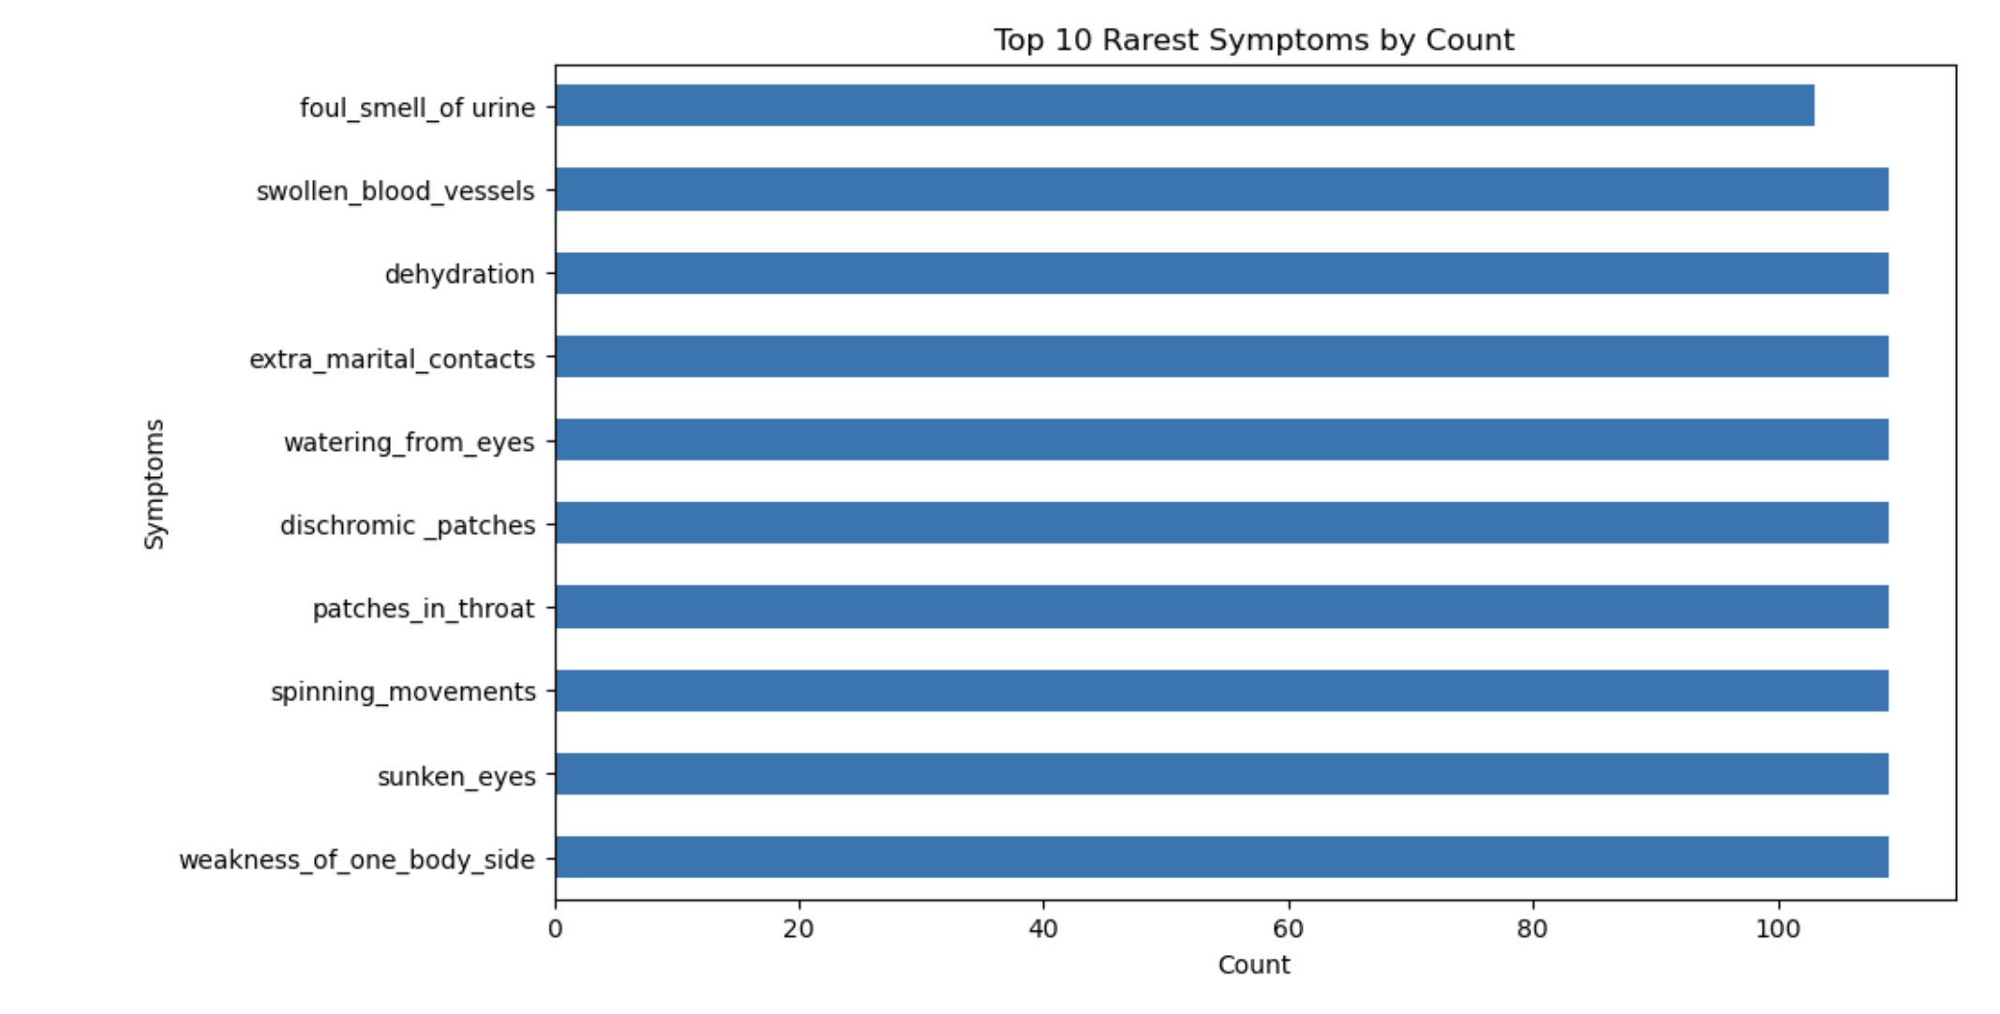
Top 10 rarest symptoms

Slide 10
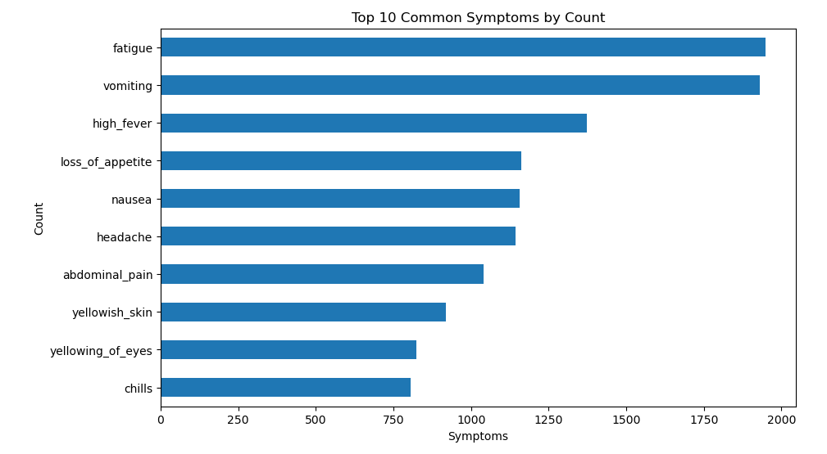
TOP 10 SYMPTOMS

Slide 11
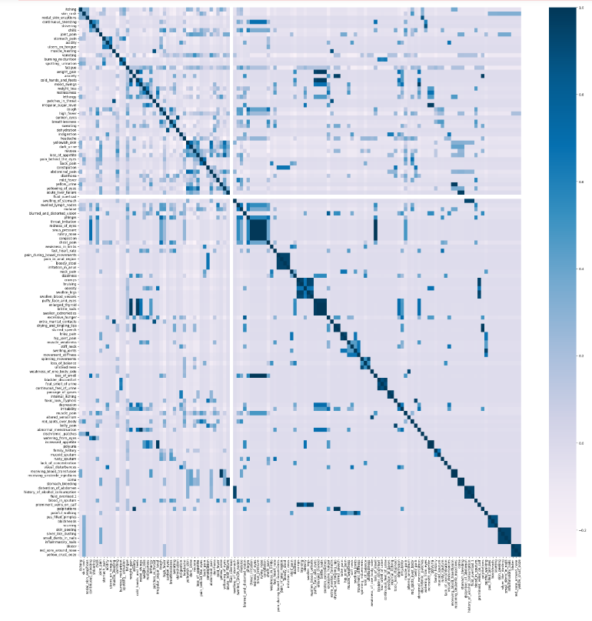
Correlation Matrix

Slide 12
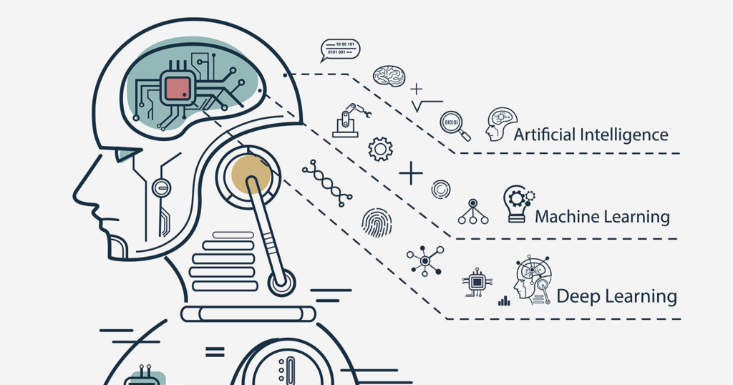
MACHINE LEARNING
Notes:
Now, with the dataset ready, its time to train our models. We have selected two machine learning models logistic regression and artificial neural network for our machine learning problem. Both models aim to solve the problem of disease prediction by learning the relationship between the predictors and the prognosis from the available data. By applying these models, we can predict the likelihood of an individual having a certain disease based on their symptoms. So the first model we choose is logistic regression which is commonly used for classification problems, in this case we use it to predict whether or not our client will develop a certain disease based on the input symptoms. Logistic regression works by modeling the relationship between the symptoms and prognosis using a logistic function. The output of the function is a probability value between 0 and 1, which represents the likelihood of a patient developing a certain disease .We then fit the logistic regression model on the training set using the predictors and the response. Once the model is trained, we evaluate its performance on the testing set and we have obtained a prediction accuracy of 99.89 percent for training data and 99.79 percent for test data, our model seems to perform really well at predicting test sets.
Next we train our training dataset on our artificial neural network model, we choose neural network because it is able to capture complex patterns and relationships amongst the predictors and they are perform better when dealing with high-dimensional datasets like ours. We built a simple neural network with an input layer, 2 hidden layers and one output layer with 41 neurons, each representing their corresponding prognosis. We choose 'adam' as our optimizer and categorical_crossentropy for our loss function and we then fit our training set into the model which it adjusting the weights and biases of the neurons using backpropagation and gradient descent to minimize the error between the predicted outputs and the actual outputs.
Once the network is trained, we evaluate its performance on the training and test set and obtained a prediction accuracy of 99.93 percent on training set and 99.84 percent on the test set, it seems that our neural network also performs well in predicting diseases, infact it is better than our logistic regression model.

Slide 13
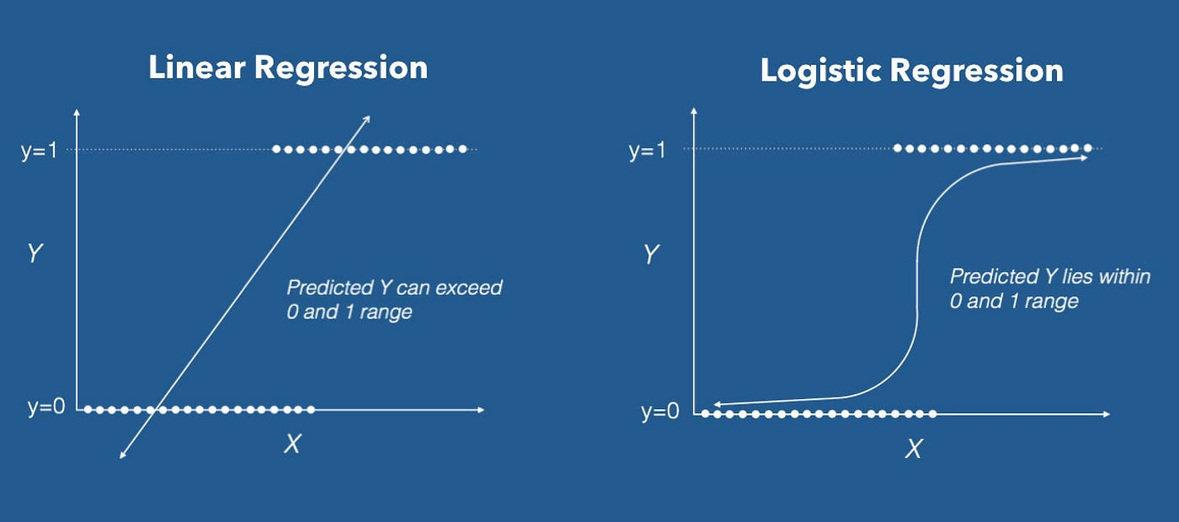
LOGISTIC REGRESSION

Slide 14
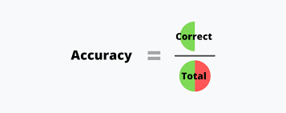
PREDICTION ACCURACY

Slide 15

ARTIFICIAL NEURAL NETWORK

Slide 16
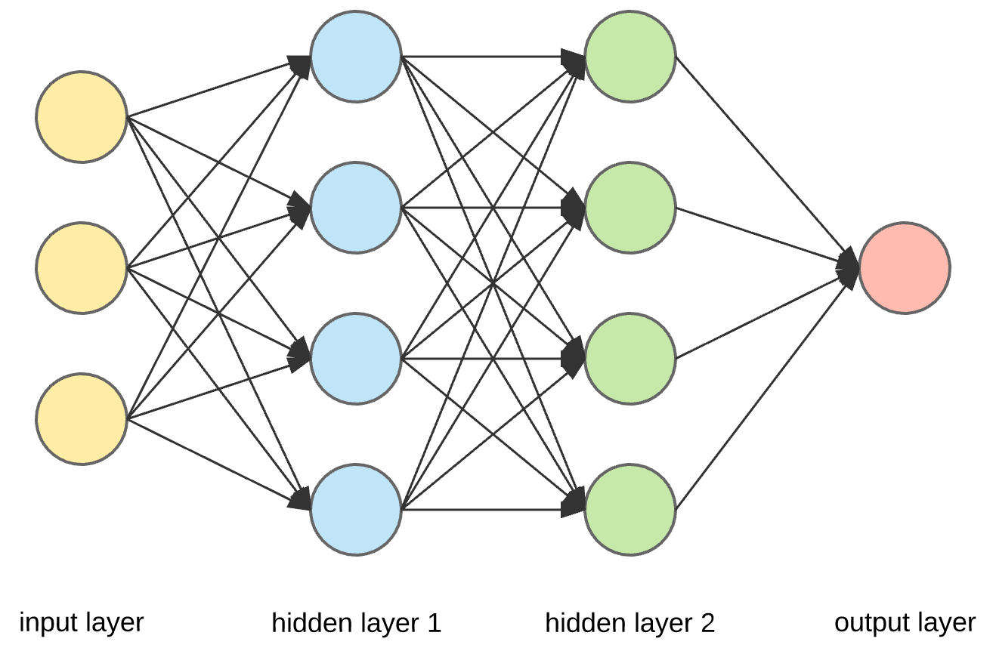
PREDICTION ACCURACY

Slide 17
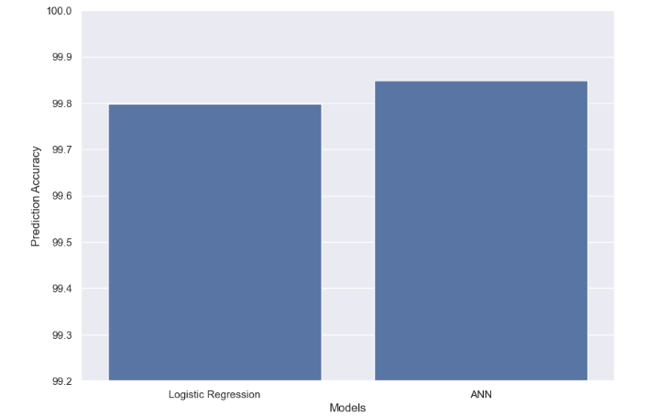
RESULTS

Slide 18
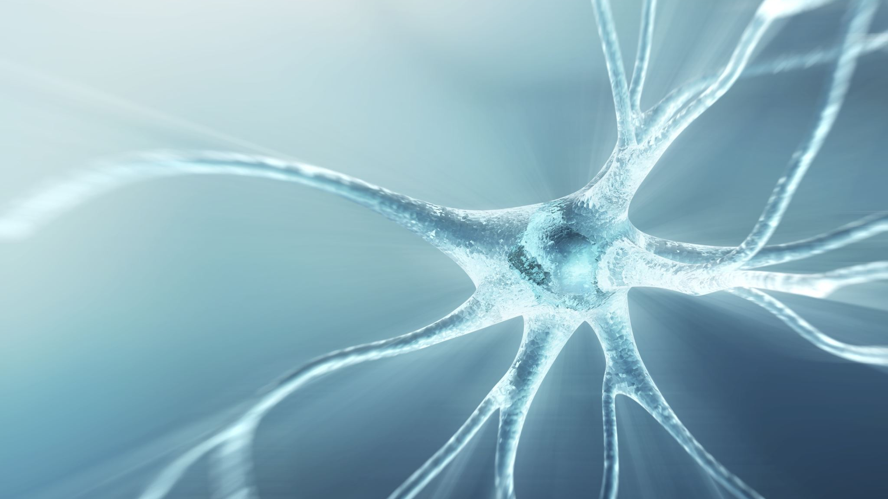
CONCLUSION
Notes:
now we have created an accurate disease prediction model that takes in various health metrics and outputs a certain disease our patient could be developing. This model can help students , working adults in fact anyone to identify their risks of developing diseases earlier and intervene with appropriate preventive measures.
This is validated by the fact that the disease prediction model has shown promising results in accurately predicting the corresponding disease given a set of symptoms in the test dataset. However, further validation and testing are required to assess the model's ultimate performance and generalizability, as limitations such as the size of data set, limited predictors as the dataset is exclusive of individual's age,gender, as well as health records which could be important predictors of diseases.
One interesting finding from the data analysis is that certain health metrics, such as blood pressure and cholesterol levels, are strong predictors of certain diseases. This can aid healthcare professionals like doctors in their diagnosis by prioritize monitoring these specific metrics in their patients.
i would recommend to integrate this disease prediction model into routine health screenings and check-ups in Singapore to aid identify patients who are at risk of developing diseases early on. This could potentially lead to better health outcomes for the population and lower healthcare costs for the government in the long run.

